Slide 1
AMRUTHA K L ANCHU C MATHEWS BLESSY JOHN GEORGE CHINCHU C MATHEWS
Face Recognition Using Python Opencv And Deep Learning

Slide 2
CONTENTS
GOAL
APPLICATIONS
CONCEPT
FLOW CHART
DATASET
SCREEN SHOTS OF OUTPUTS
CONCLUSION
REFERENCES

Slide 3
GOAL
Our goal is to train a convolution neural network using keras and deep learning to recognize and classify each of the faces
The main objective of the project is to train and recognize the face of the person using CNN and to detect the faces in an image/video using OpenCV and label him with square box along with the accuracy.

Slide 4
APPLICATIONS
Facial Recognition is being extensively used in surveillance systems.
Crime Detection and Forensic.
To make secure and reliable online payments.
Password Authentication.
Track school attendance
Diagnose diseases

Slide 5
CONCEPT
A Convolutional Neural Network (ConvNet/CNN) is a Deep Learning algorithm which can take in an input image, assign importance (learnable weights and biases) to various aspects/objects in the image and be able to differentiate one from the other.
Face recognition based on the geometric features of a face is probably the most intuitive approach to face recognition. The recognition was performed by calculating the euclidean distance between feature vectors of a probe and reference image.

Slide 6
FLOW CHART
Input a dataset
Fig 1: Training(Image)
Resize and converting the image to n-d array
Do the necessary preprocessing
Compile and fit the model using CNN
Adjusting the epochs to get the maximum accuracy

Slide 7
Fig 2:Testing(Image)
Input an image.
Use CNN.predict method to predict the image.
If prediction?
Print “incorrect”.
No
Yes
Label the image and print the accuracy.

Slide 8
Fig 3:Training (video)
Input a video
Convert the video into different frames
Extract the coordinates of faces
Train the image using CNN
128-d feature vector embeddings

Slide 9
Fig 4:Testing(video)
Input a video
Converting the face coordinate into 128-d feature vector embeddings
Compare the test video embedding with the trained video embedding
Predict the face and label it

Slide 10
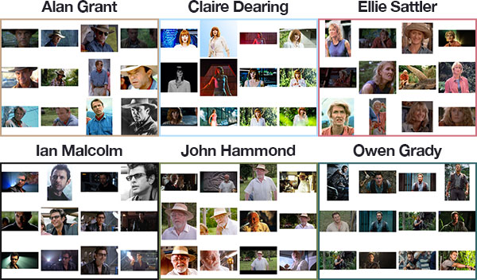
DATASET

Slide 11
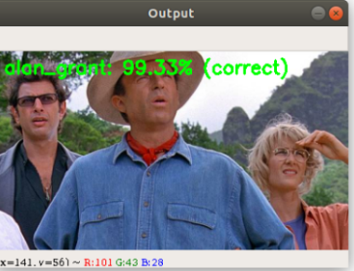
SCREEN SHOTS OF OUTPUTS
Output of the given input image:

Slide 12
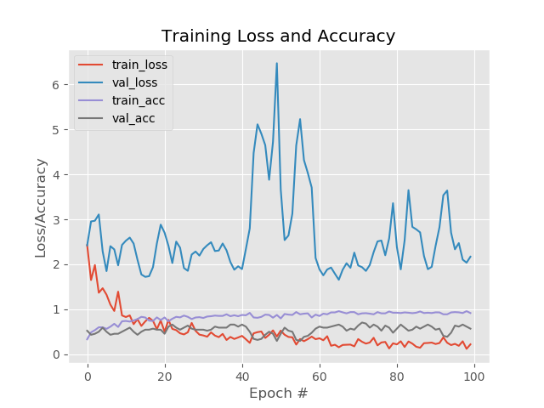
Accuracy/Loss Vs Epochs

Slide 13
Output of the input video file:

Slide 14
CONCLUSION
By doing this project we are trying to implement a model that can detect and identify faces from a video/images by training it with CNN.
Recognizing the image of a person in this project can be further extended to real time applications like attendance recorder , security purposes ,medical purposes.

Slide 15
REFERENCES:
Deep Residual Learning for Image Recognition – Kaiming He, Xiangyu Zhang, Jian Sun, Shaoqing Ren
https://medium.com/@ageitgey/machine-learning-is-fun-part-4-modern-face-recognition-with-deep-learning-c3cffc121d78

Slide 16
Thank You…..

